Slide 1
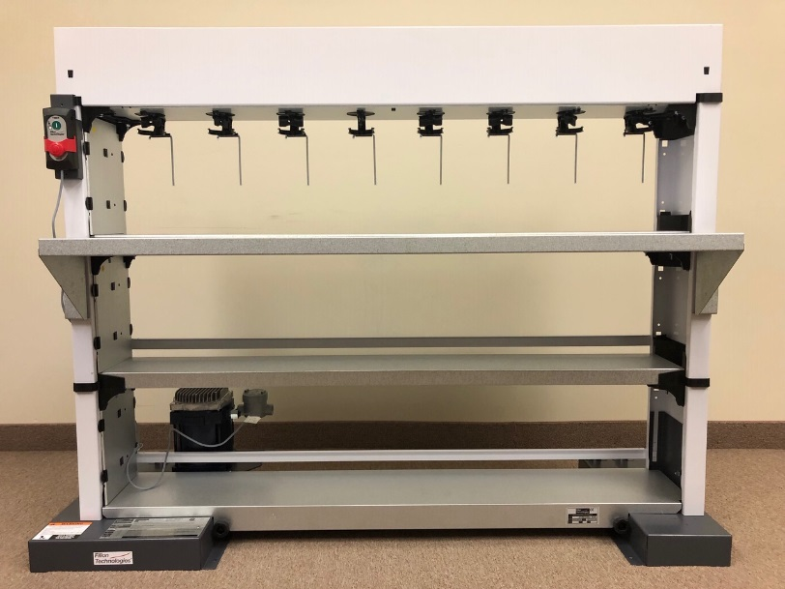
MINI-MIX PLUS
Installing the Pedestal and Work Surface Base
E18990

Slide 2
= 1 person = 15 min
Features and Benefits
Thank you for purchasing the Mini-Mix Plus mixing machine. The latest version includes several new valued features.
Mini-Mix Plus is equipped with a new Dempro ‘Slow-Start’ motor that can be programmed to run automatically <twice daily> according to the painter’s preferred schedule. The mixing cycle operates for 15-minutes with the second cycle beginning exactly 5 hours and 45-minutes after the first. Once mixing commences, the motor will begin turning ‘slowly’ until it gradually reaches full-speed. The benefit to the slow-start functionality is to reduce foaming issues and reduce wear and tear to the machine’s components caused by aggressive start-up torque.
To watch the video tutorial on how to use and program the motor, please visit
YouTube and search “Fillon Dempro”.
Here is a link: https://www.youtube.com/watch?v=j0iaEQFAb-s
The new Dempro ‘Slow-Start’ motor is also equipped with a pre-installed UL/CSA
Explosion-proof junction box to facilitate the installation and make it less costly
since the box is usually furnished by the electrician.
The new Pedestal with Work Surface (referred to as ‘Work Table with Pedestal’ in the instructions) now offers two convenient storage shelves for extra toners, non-mixing products, and general storage needs. In addition, it will elevate the mixing shelves to a more convenient ‘waist’ level height.
All Fillon mixing machines are now like ‘Transformers’ because they will accommodate both mixing and storage shelves on a stand-alone base. We believe that this will enable the coatings manufacturer’s and shops to have maximum flexibility with managing paint lines without needing to replace an existing mixing machine base.
E18990

Slide 3
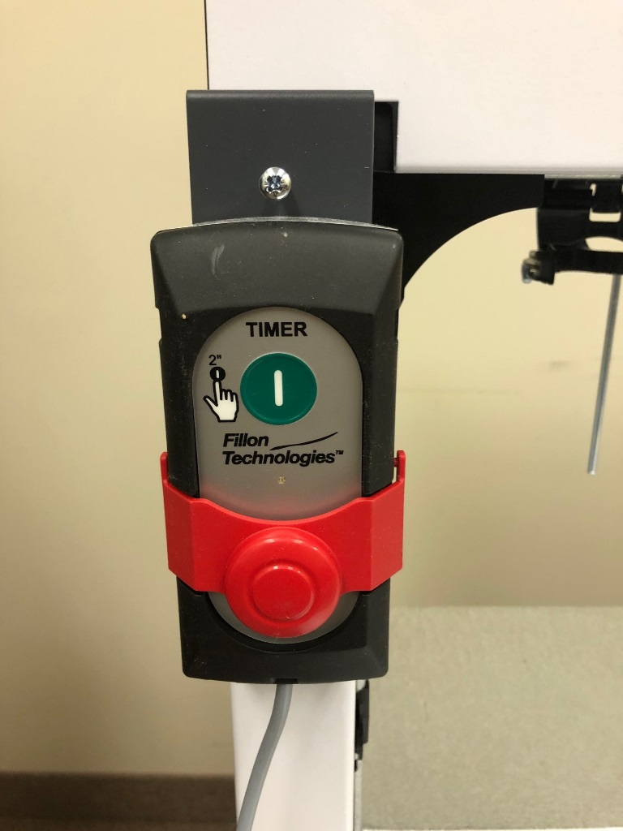
DEMPRO MOTOR QUICK-START
Manual Mode:
When power is delivered to this timer the LED indicator button will blink GREEN rapidly. To initiate mixing, press the green START button and hold it for 2-seconds… The LDE will blink in ORANGE and then GREEN. The motor will begin by turning slowly and take 20-seconds to reach full speed.
If you want to STOP the mixing cycle before the program has finished press the RED stop bar.
Automated Mixing:
Press and hold the RED stop bar until the LED indicator turns ORANGE then release. Next, press the green START button and hold it for 1-2 seconds. The indicator light will blink ORANGE for 10-seconds and then the mixing cycle will commance.
The SCOND mixing cycle will begin exactly 5-hours and 45-minutes AFTER the frist cycle is completed.
Important: If after completing the above steps and the LED indicator is a solid GREEN, repeat the programming steps to initialize.
LED Light
Starting times for Automated Mixing:
If you want the automated mixing program to begin at a specific time each day, a person will need to be present at that exact time to program the motor as explained above.
Power Outage:
If the painter arives at the shop and notices the LED indicator blinking GREEN repeatedly, it means thet there was a power outage. The paint chould be stirred immediately in manuel mode. The painter will also need to re-program the timer according to his preferred strating time for the automated mixing mode since the memory was lost during the outage.
Trouble-Shooting:
If the timer led blinks RED severel times and won’t start in manual mode then the motor/timer need to be replaced. Call Fillon Technologies for a replacement. Note: the warranty is valid 2-years from the purchase date.
E18990

Slide 4
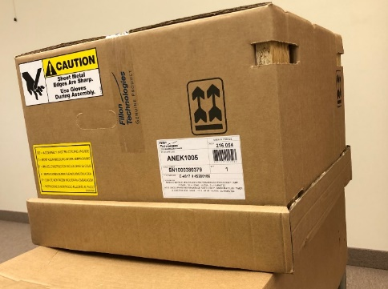
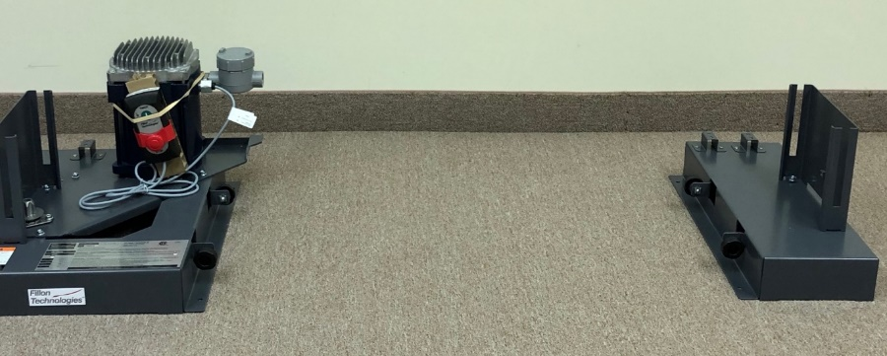
Mini-Mix Plus
Assembly Instructions
MISE EN SERVICE & UTILISATION
PLEASE NOTE:
These instructions are intended only for customers who purchased the optional Pedestal and Work Surface in addition to the Mini-Mix Base and motor assembly. If you did not, then please refer to the standard Quick-Mix Plus assembly instructions included with the motor assembly. The installation will be exactly the same EXCEPT that Mini-Mix machines DO NOT include back-up storage.
Step 1:
Open the motor assembly box and position the right and left (with motor attached) feet about 5’ away from each other at the installation site while allowing a 2-foot clearance behind for the electrical connections.
Motor Assembly Box
E18990

Slide 5
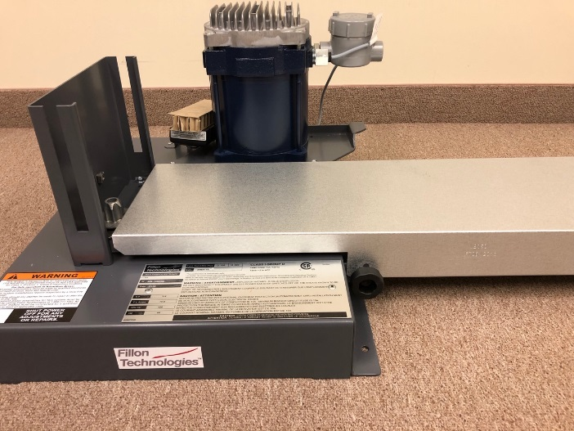
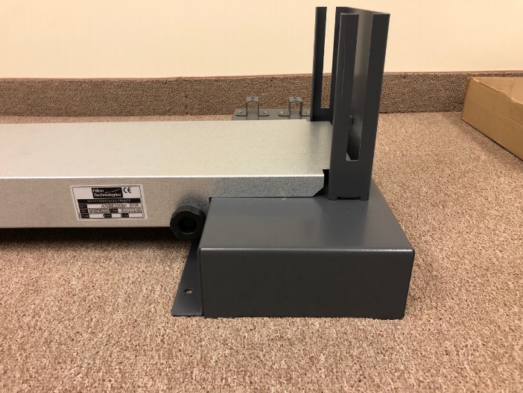
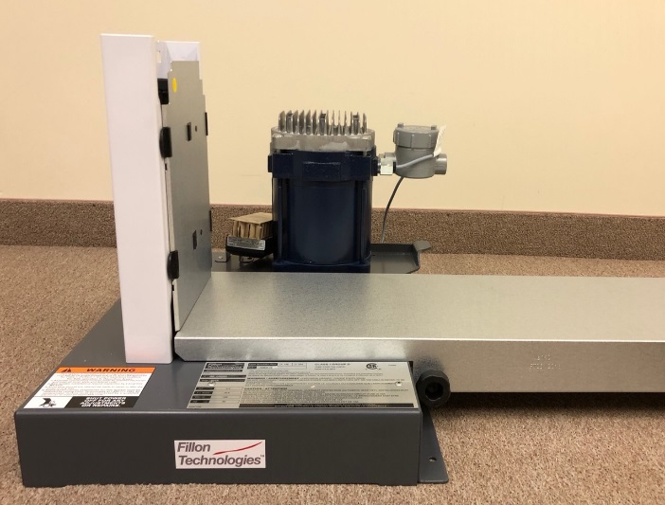
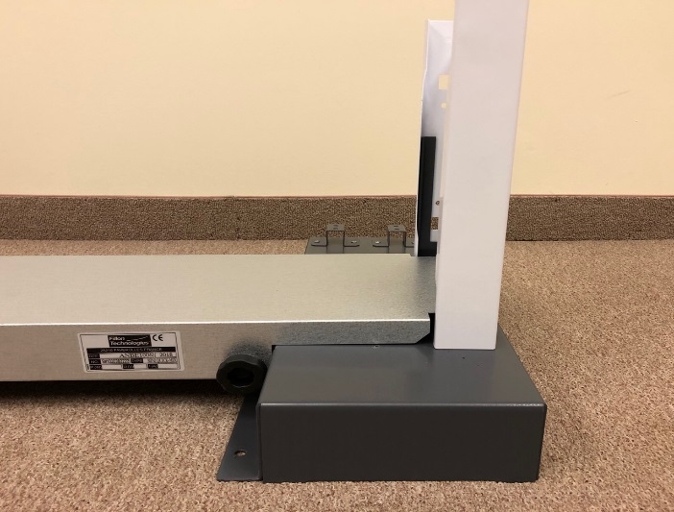
Mini-Mix Plus
Assembly Instructions
CONSIGNES DE SECURITE &
ANALYSE DU RISQUE
Step 2:
Open the base unit box and install the floor tray onto both feet then secure it in place with the 4 x black serrated rollers. Note: the ID Plate should be facing the front on the right hand side.
Step 3:
Install the right and left side panels by inserting them into the sleeve on each foot. To line-up the driveshaft, rotate it with your hand until you feel it ‘drop’ into the drive block. Important: Set aside the mechanical shelf and Header Board until later.
E18990

Slide 6
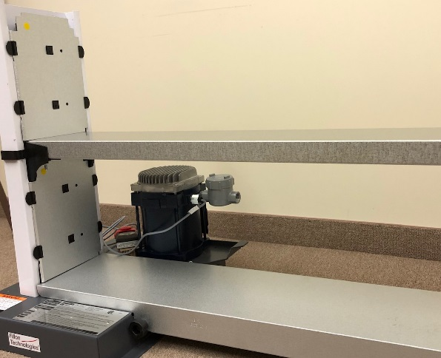
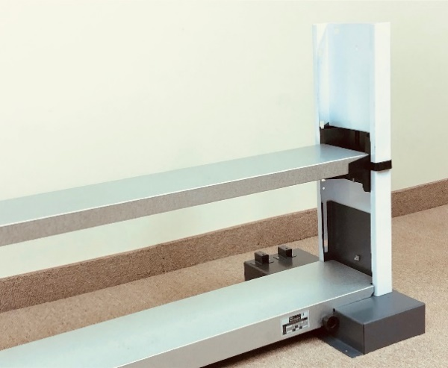
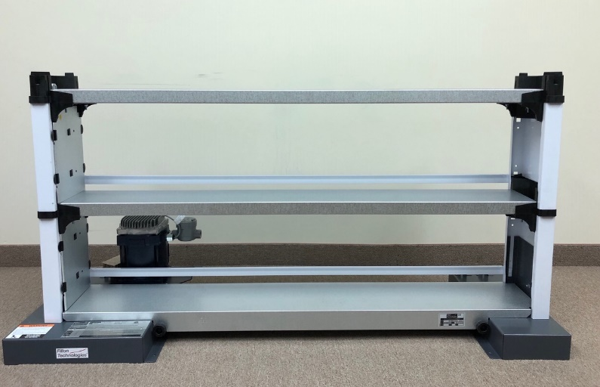
Mini-Mix Plus
Assembly Instructions
DYSFONCTIONNEMENTS & SOLUTIONS
Step 4:
Open the work table with pedestal carton and remove the cardboard trays with the side panels and set them aside. Now, install the Alu/Zinc storage shelf into the LH/RH side panels by locking it into place- taking care to ensure that the driveshaft is properly aligned. Note: if the drive shafts are not aligned correctly then the machine will look ‘crooked’ or have spaces between each shelf. Next, install the next set of LH/RH side panels as explained in Step 3.
Step 5:
Install the next Alu/Zinc storage shelf onto the LH/RH side panels as shown in
The picture to the right.
Step 6:
Mount the two white painted support rods by inserting the tabs
into their respective slots and pressing down firmly until you hear them “click”.
E18990

Slide 7
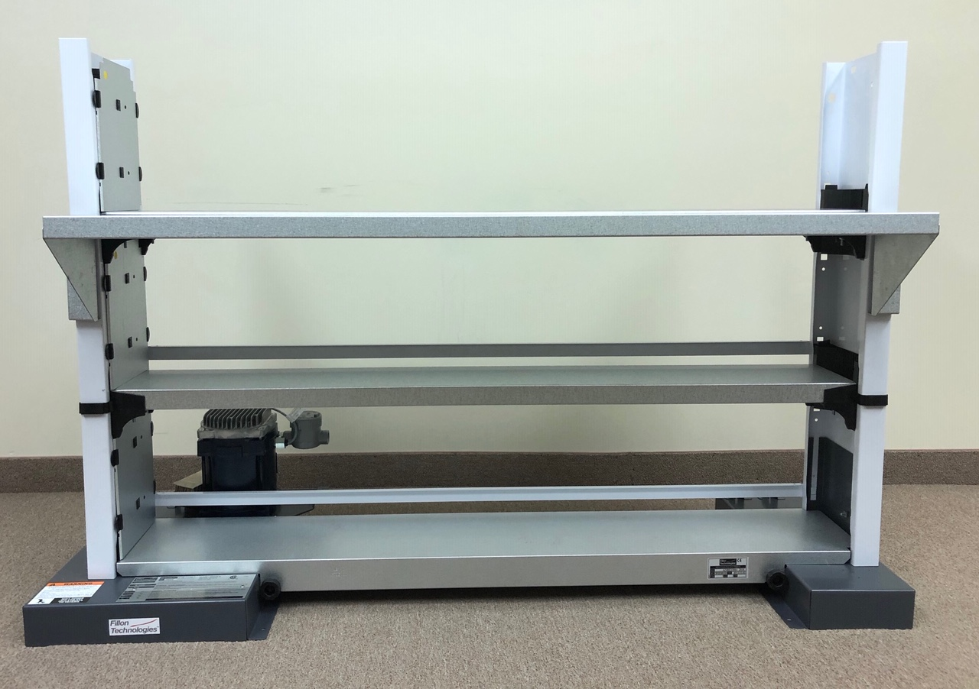
Mini-Mix Plus
Assembly Instructions
NETTOYAGE, ENTRETIEN & DEMANTELEMENT
WORK TABLE
Step 7:
Insert the RH/LH work table brackets into position by pressing down firmly to “click” them into place.
Step 8:
Find the hardware bag (part # J24960) and pre-install the 4 x 10mm bolts and nuts ‘loosely’ into both ends of the Alu/Zinc work surface, then align them into the slots of the table brackets as shown. Tighten all four bolts securely.
E18990

Slide 8
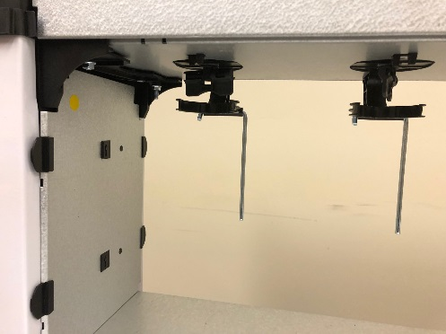
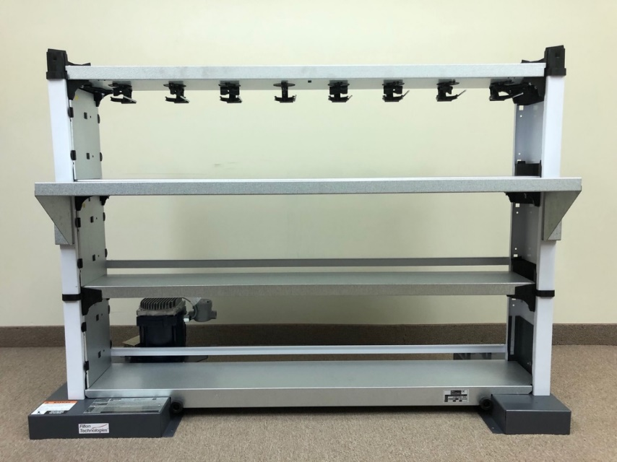
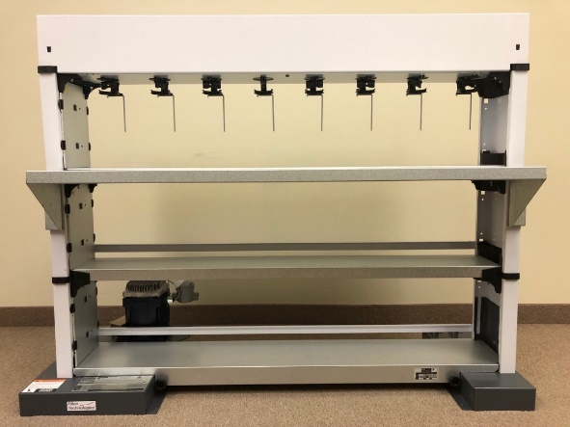
Mini-Mix Plus
Assembly Instructions
NETTOYAGE, ENTRETIEN & DEMANTELEMENT
Step 9:
Install the remaining LH/RH side panels as before, and then mount the mechanical shelf and its Alu/Zinc cover together. Note: after the shelf is installed pull the ‘gates’ down on each Quick-Link assembly as shown in the accompanying photo.
Step 10:
Mount the header board by aligning the tabs into the corresponding slots on the topmost divider blocks.
E18990

Slide 9
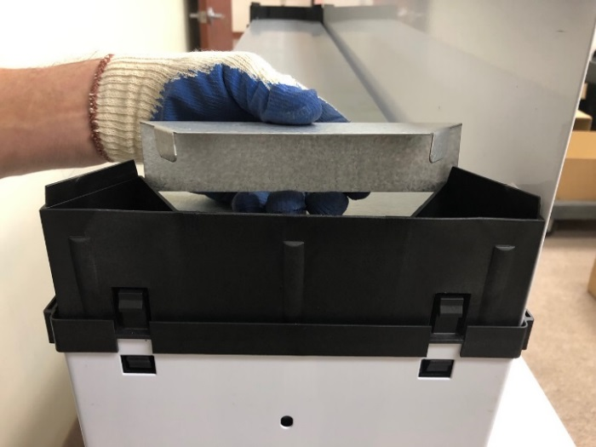
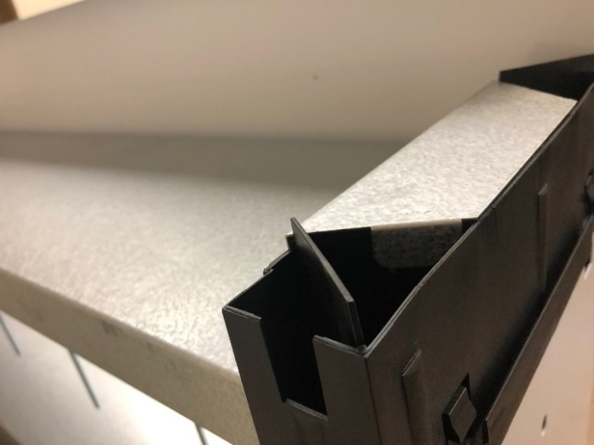
Mini-Mix Plus
Assembly Instructions
NETTOYAGE, ENTRETIEN & DEMANTELEMENT
Step 11:
Install the safety cover onto the top drive block by aligning the tabs as shown.
Step 12:
Press-fit the electric timer onto its bracket until it “locks” into place, then mount it to the LH front slot of the appropriate divider block. Finally, secure it with the long bolt provided.
E18990

Slide 10
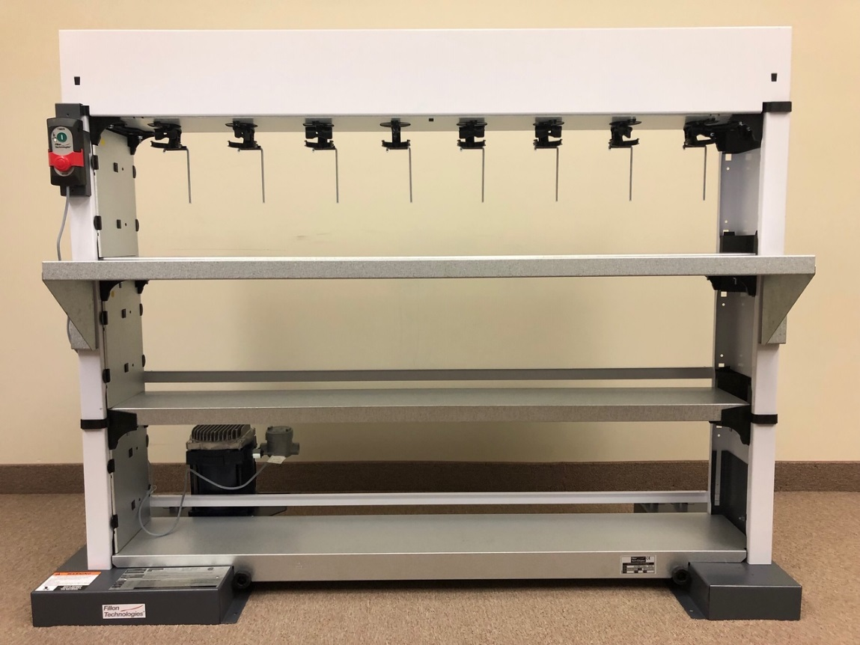
Mini-Mix Plus
Assembly Instructions
NETTOYAGE, ENTRETIEN & DEMANTELEMENT
Electrical and Grounding Requirements
Note: Please follow the directions on pages 7, 8, and 9 of the Quick-Mix Plus owner’s manual included with the motor assembly.
For questions or spare parts,
please contact Fillon Technologies at:
800-777-1583 or email : salesUS@fillontech.com
E18990

